Slide 1

STEND CIPHER
By Ahmed Dillo

Slide 2

1) Introduction
The Cipher is a fundamental component of hybrid cybersecurity, ensuring data confidentiality and protection against unauthorized access.
STEND cipher is designed to provide a secure and efficient method for encrypting sensitive information while maintaining a spatial substitution table and specific encryption methods.

Slide 3
2) Algorithm Overview
This algorithm falls under the category of non-asymmetric encryption. We have both of keys and the both of them are private. Set by the user.
To process the message that is to be encrypted, we first need to transmit it into my special substitution table (Xavi Table). Then, the algorithm will process its corresponding numerical values and mix the keys sequentially.
The key mixing will be processed using the "collection operation." The "exponentiation operation" was attempted, but I encountered extremely large numbers, which could potentially be infinite and difficult to decrypt.
This cipher is designed for encrypting words and can be considered a hybrid algorithm, as it features a unique substitution table and shares similarities with the Vigenère cipher.

Slide 4
3) The Encryption
1) The first step we need to take is to write the values of the message we want to encrypt into the "Xavi table" that I specially prepared (Note: uppercase letters will be converted to lowercase when encrypted in this cipher!).

Slide 5
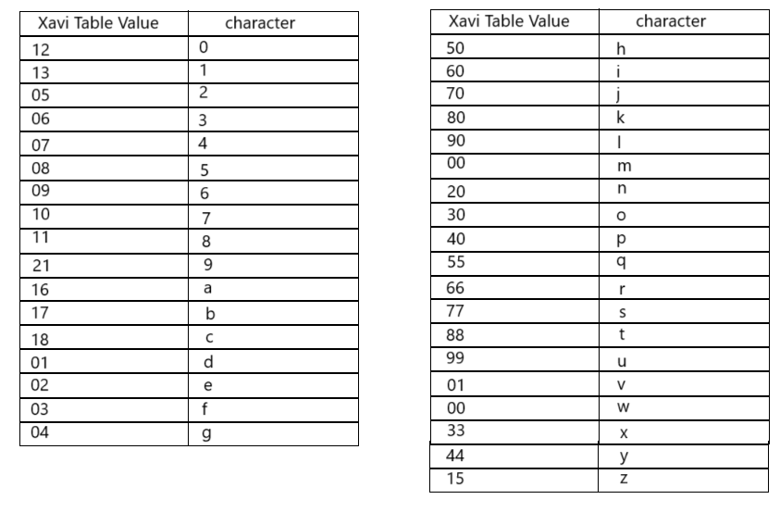
Xavi Substitution Table:

Slide 6
Key Mixing:
We mix the plaintext with the first key, which can be set by the user. Alternatively, a future version of the program will be able to suggest a large key (at least as long as the plaintext).
Then, we mix the second key with the result of the previous operation.
It is preferred for the keys to be large prime numbers, but non-prime numbers can also be used.

Slide 7
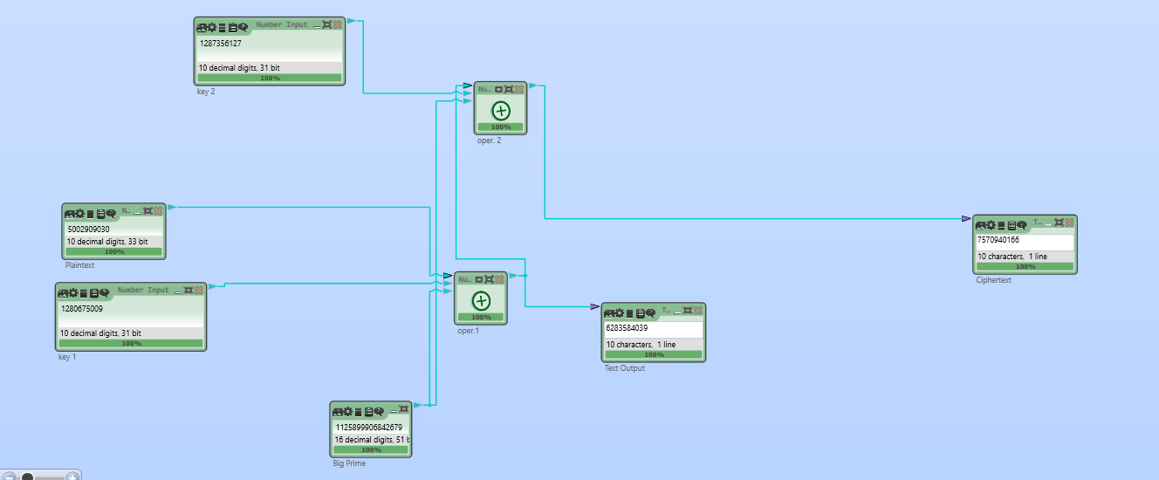
The Appearness of Encryption:
İn this example we encrypted «hello» word, or with its xavi table value=5002909030

Slide 8
4) The Decryption
To decrypt the ciphertext, we first subtract Key 2 from it. Then, we subtract Key 1 from the result obtained in the previous step.
After these operations, the final numerical output can be converted back into readable text using the Xavi Table, ensuring the original message is accurately reconstructed.

Slide 9
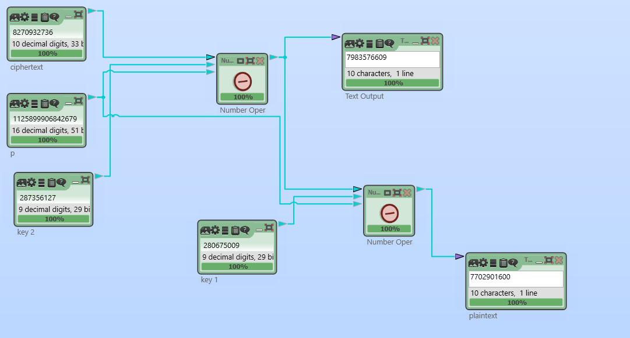

Slide 10
Final Thoughts & Acknowledgments
Although this project is not large-scale or highly secure, it holds great personal significance for me and will continue to do so throughout my life. After all, this may be the first cryptographic product I have ever created. Thank you for taking the time to review my project. Lastly, I would like to express my gratitude to the «CrypTool 2.1» platform for providing a free and open-source workspace, and I truly appreciate their efforts.

